Slide 1
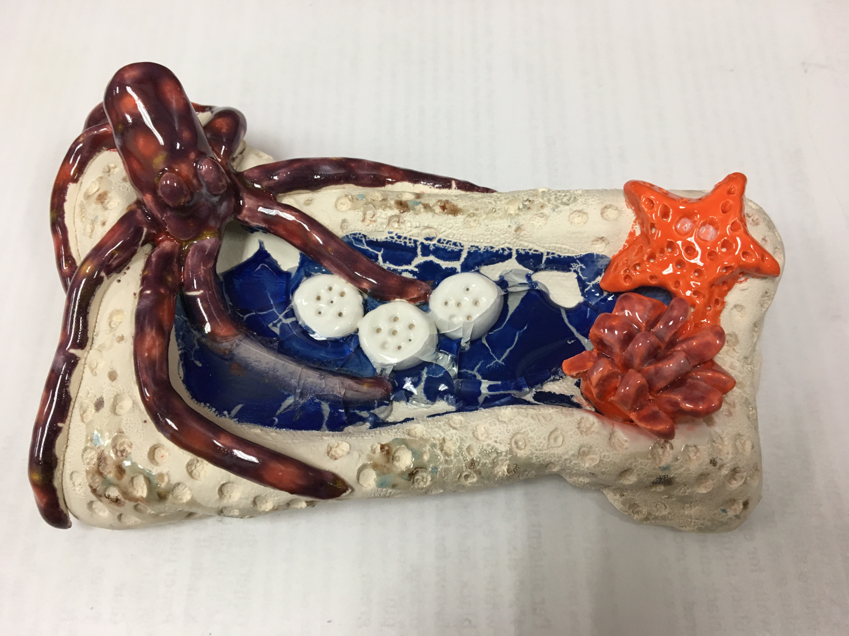
Clay with melted glass

Slide 2
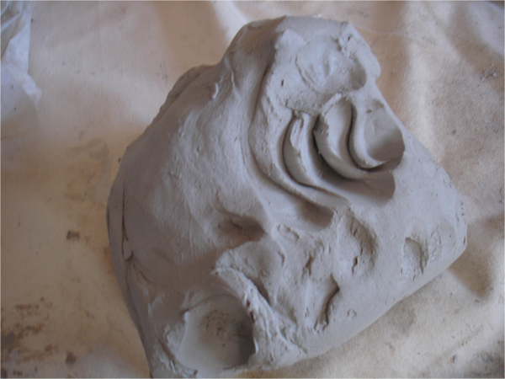
Plastic Stage
Clay is workable & moldable. It can be pushed, stretched, stamped, or impressed.

Slide 3
Greenware Stage
When clay is in the stages of drying: wet, damp, soft leather-hard, stiff leather-hard, dry, and bone dry.
Once it is dry and light gray in color, it becomes very fragile. If placed in water, it will return to a lump of soft clay.
Must be bone dry before firing in the kiln (1-2 weeks of air drying).

Slide 4
Bisqueware Stage
After clay is bisque fired in the kiln (goes up to approximately 2000 degrees and takes 24 hours)– becomes hard, durable, waterproof

Slide 5
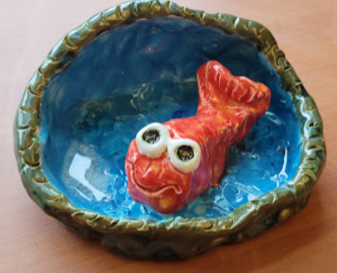
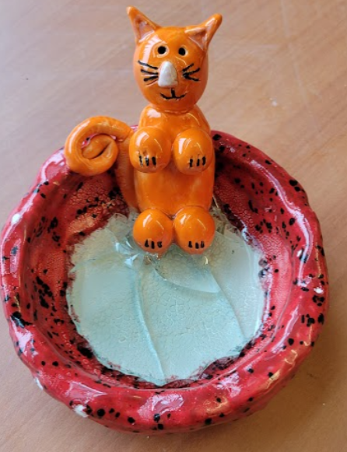
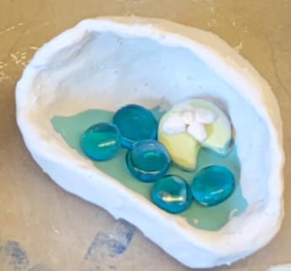
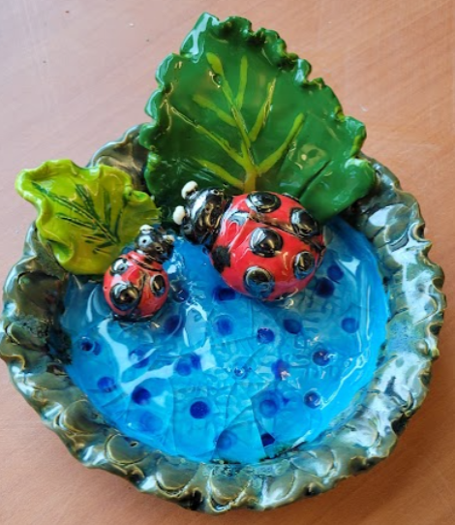
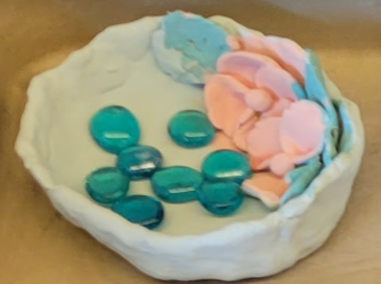
We will be meeting twice for Clay this month
Today to make the wet clay bowls
Clay must dry for 7-14 days before going into the kiln to Bisque Fire.
It will then go into the kiln to fire to become hard.
In 1 – 2 weeks to add color to your bowls.
We will be painting on glaze.
Glaze is a liquid mixture of clay, powdered glass and frit, and water.
We will be adding translucent glass beads to the bottom of your bowls.
Your glazed bowls will go into the kiln to be Glaze Fired.

Slide 6
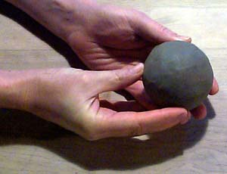
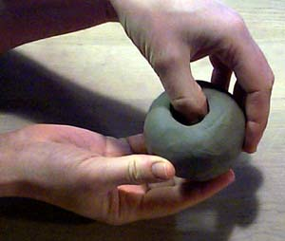
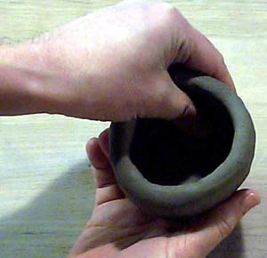
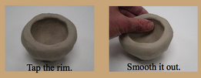
Steps for making pinch pots
Step 1) Make the clay into a round ball
Step 2) Push your thumb in the center but leave ¼ thick clay on bottom and walls
Step 3) Pinch and turn while holding in the palm of your hand
Steps 4 & 5)
Notes:
Docent note – you may want to watch the you tube video for how to make a pinch pot at
http://www.youtube.com/watch?v=5UL5fQtO6qk

Slide 7
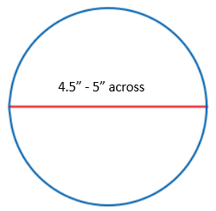
Steps
Making the Pinch Pot bowls
Size of your bowl
Start out
Start out with a baseball size piece of wet clay.
Divide the clay in 1/3 and 2/3 pieces.
Set
Set the 1/3 size piece aside.
Take
Take the bigger piece and roll into a perfect ball shape.
Stick
Stick your thump into the center of the big ball, partial way.
Pinch out the center with both thumbs while rotating your ball, until the bowl is formed.
Should be about 4-5”
Thickness of your bowl should be ½” thick on all sides. (floor, walls)
Height of your bowl’s wall, be EQUAL OR GREATER THAN 1” INCH.
Or else the glass will spill out in the kiln and adhere to the kiln.

Slide 8
Steps Continued…..
Score & Slip – Attaching Clay to Clay
Turn bowl over and write your First Name, your teacher’s last name beginning letter, and year.
Alice
R
2023
Turn bowl back over to the top side.
Dab water on your finger and smooth out all cracks and tears.
Decorate the rim and exterior wall of the bowl (optional)
Use your smaller 1/3 ball of clay to make a creature or scene inside your bowl.
To attach the objects to each other or to the bowl, remember to use the Score and Slip method.
Use wire brush or other sharp tool to create score marks (think Velcro ruff)
Score the side you are attaching
Score the receiving side of the bowl or object
Add a drop of water to the receiving side score marks.
Press firmly pieces together.
Smooth join creases with your finger or a smoothing tool.

Slide 9
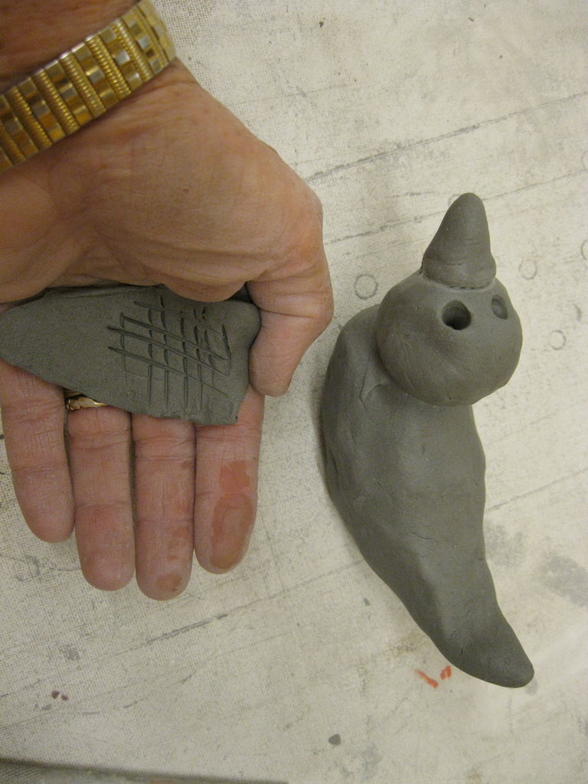
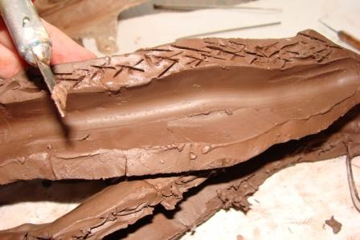
How to attach clay pieces (Score and Attach)
Make scratches in clay like small tic tac toe marks. This is called scoring.
Both pieces being attached need these scratch marks.
Put a drop of water on each piece over the scratch marks.
Push the pieces together by connecting the scratch marks like velcro.

Slide 10
5th Grade Clay with Melted Glass
Tips to remember with this project:
Your clay shape MUST have walls at least one inch high so that when the glass beads melt they will stay in the clay and not leak out.
Don’t make the walls or floor of project too thin or they will not be stable.
Score and attach any clay pieces together (make lots of # signs on both pieces that you are joining)
Use a few drops of water to smooth any cracks in clay.
Glazing:
*This glass will have a “cracked” look to it after firing in the kiln.
*You can paint the inside of the clay container with any color glaze and add clear blue glass.
Notes:
This print out is handy to place on each table to remind the students.

Slide 11
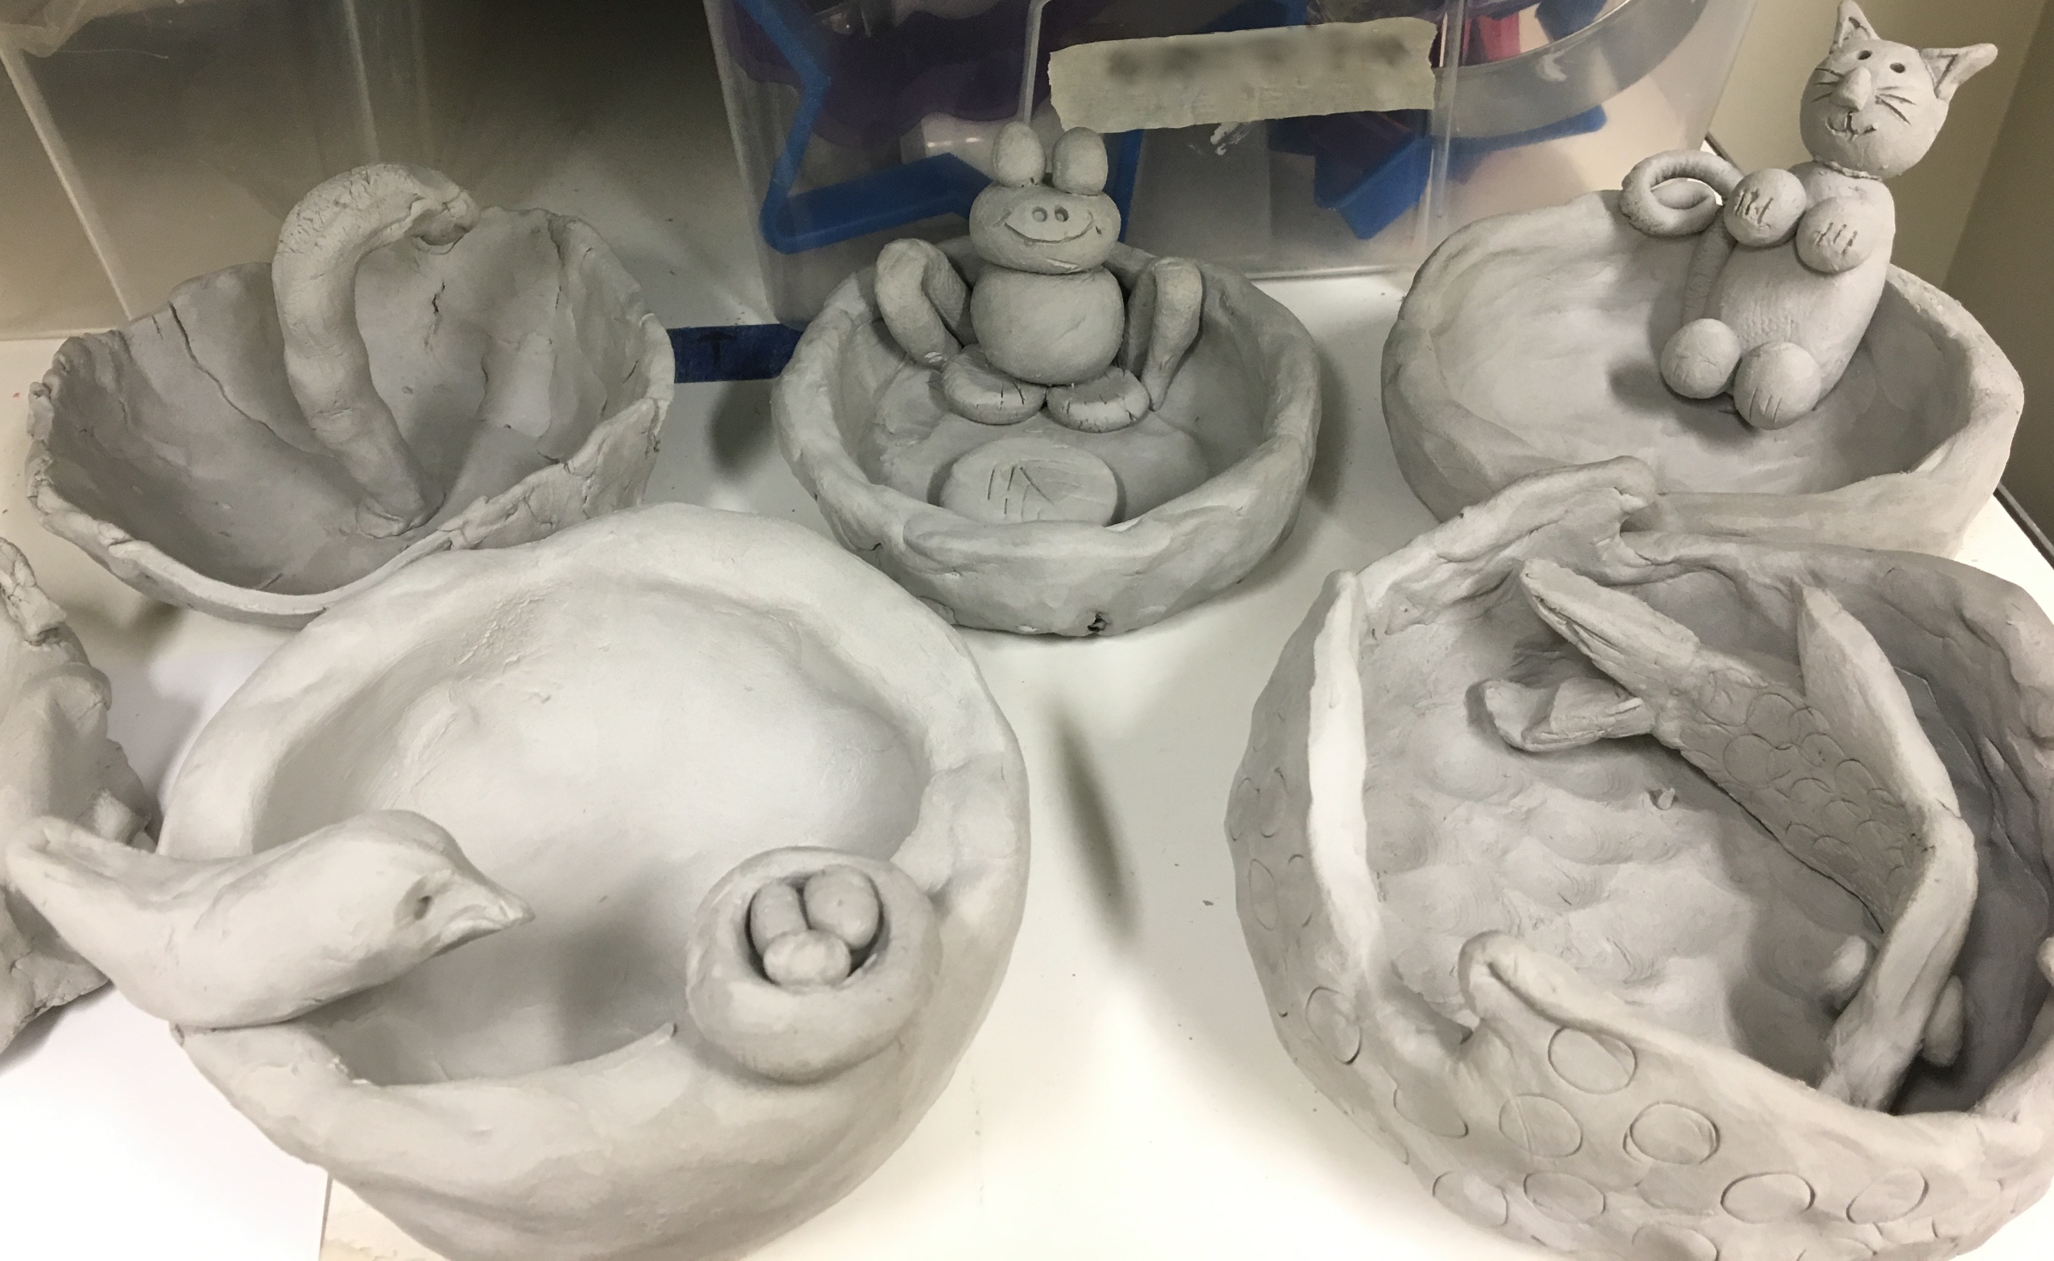
Examples of ideas for this project
Notes:
Getting started:
Students receive one canvas cloth on the desk, one 3-4” Ball of clay, dull pencil for writing name, cutting knife, texturizing tools (tongue depressors, screws, pinecones, marker caps, etc.), tray for project drying, bowl with few drops of water for fingertip smoothing). Use 5-6” paper or plastic plates to keep the base size of the pinch pot bowls uniformly the same size as each other.

Slide 12
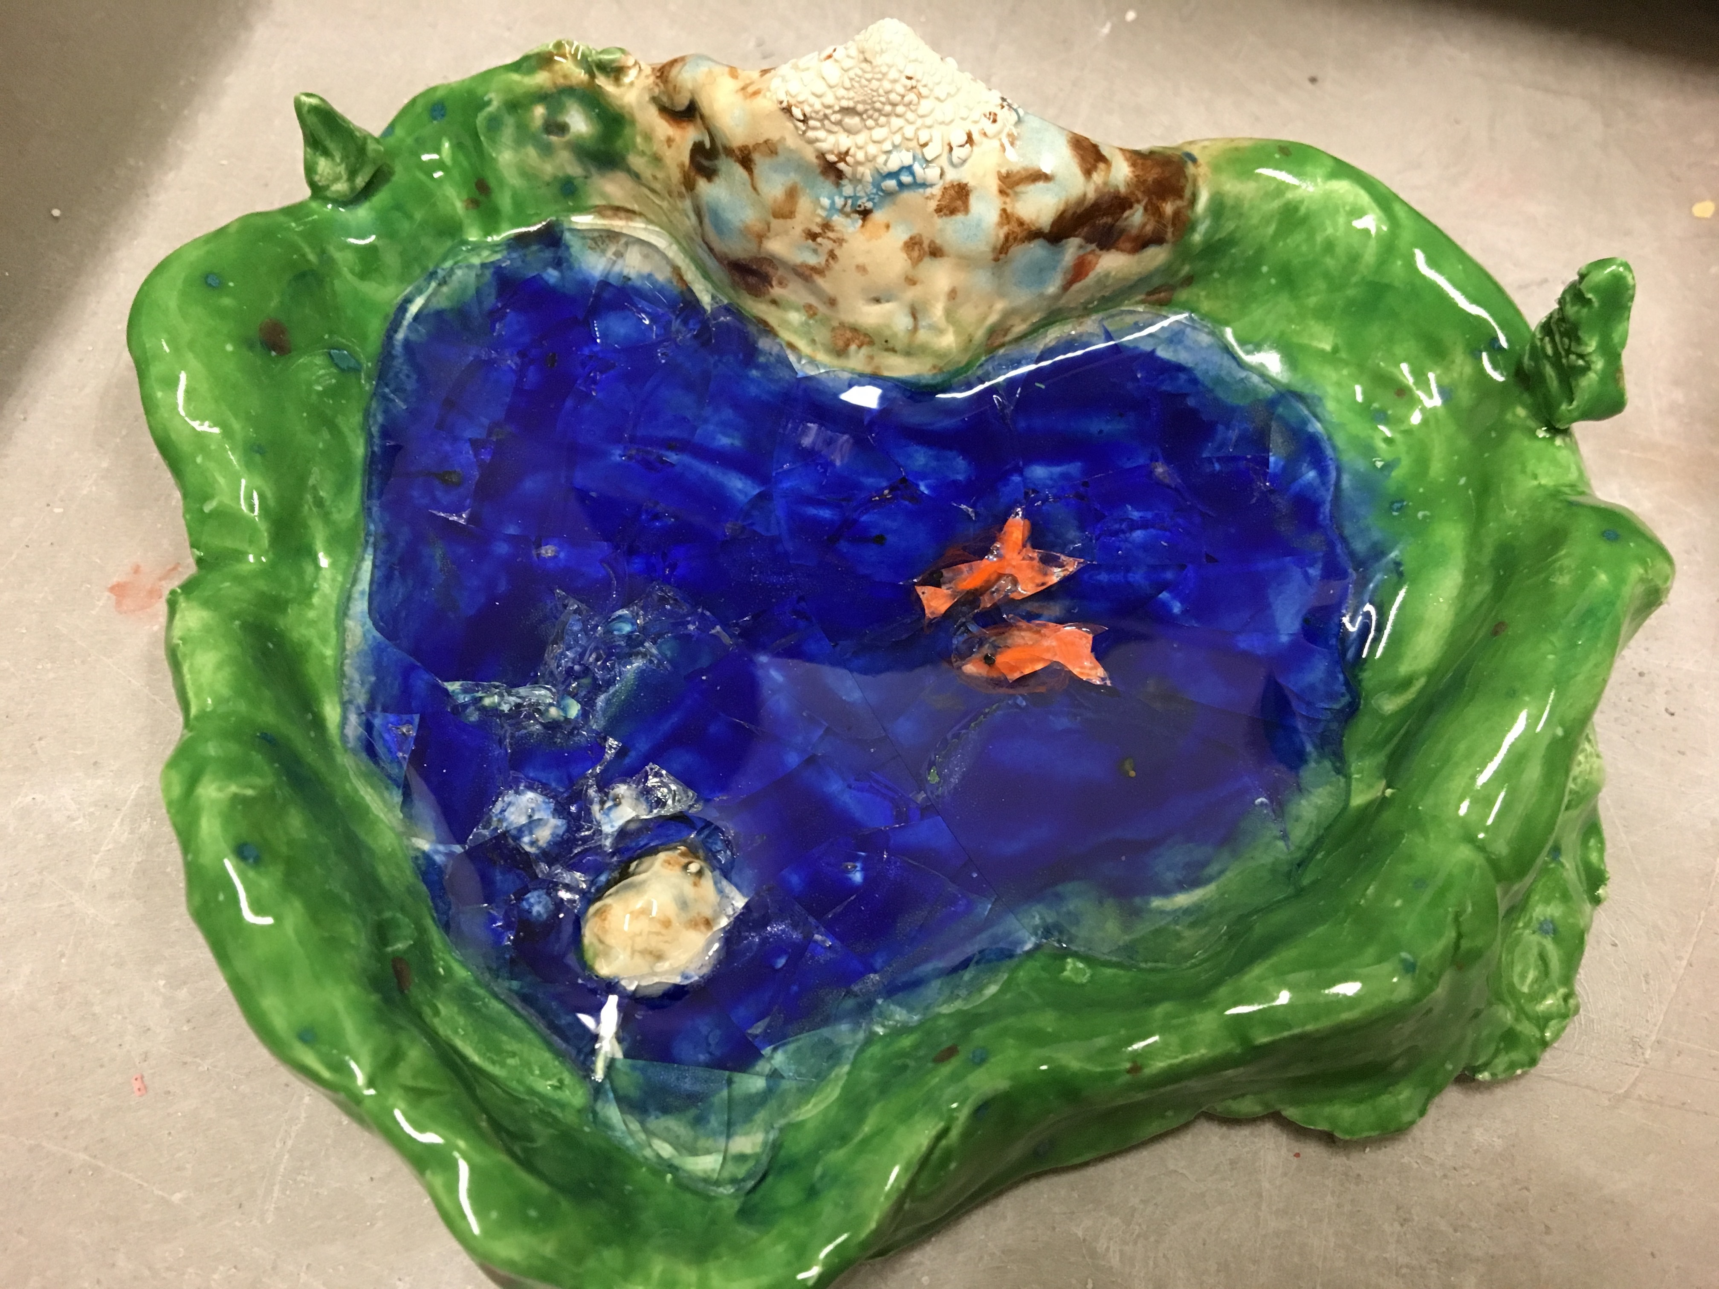

Slide 13
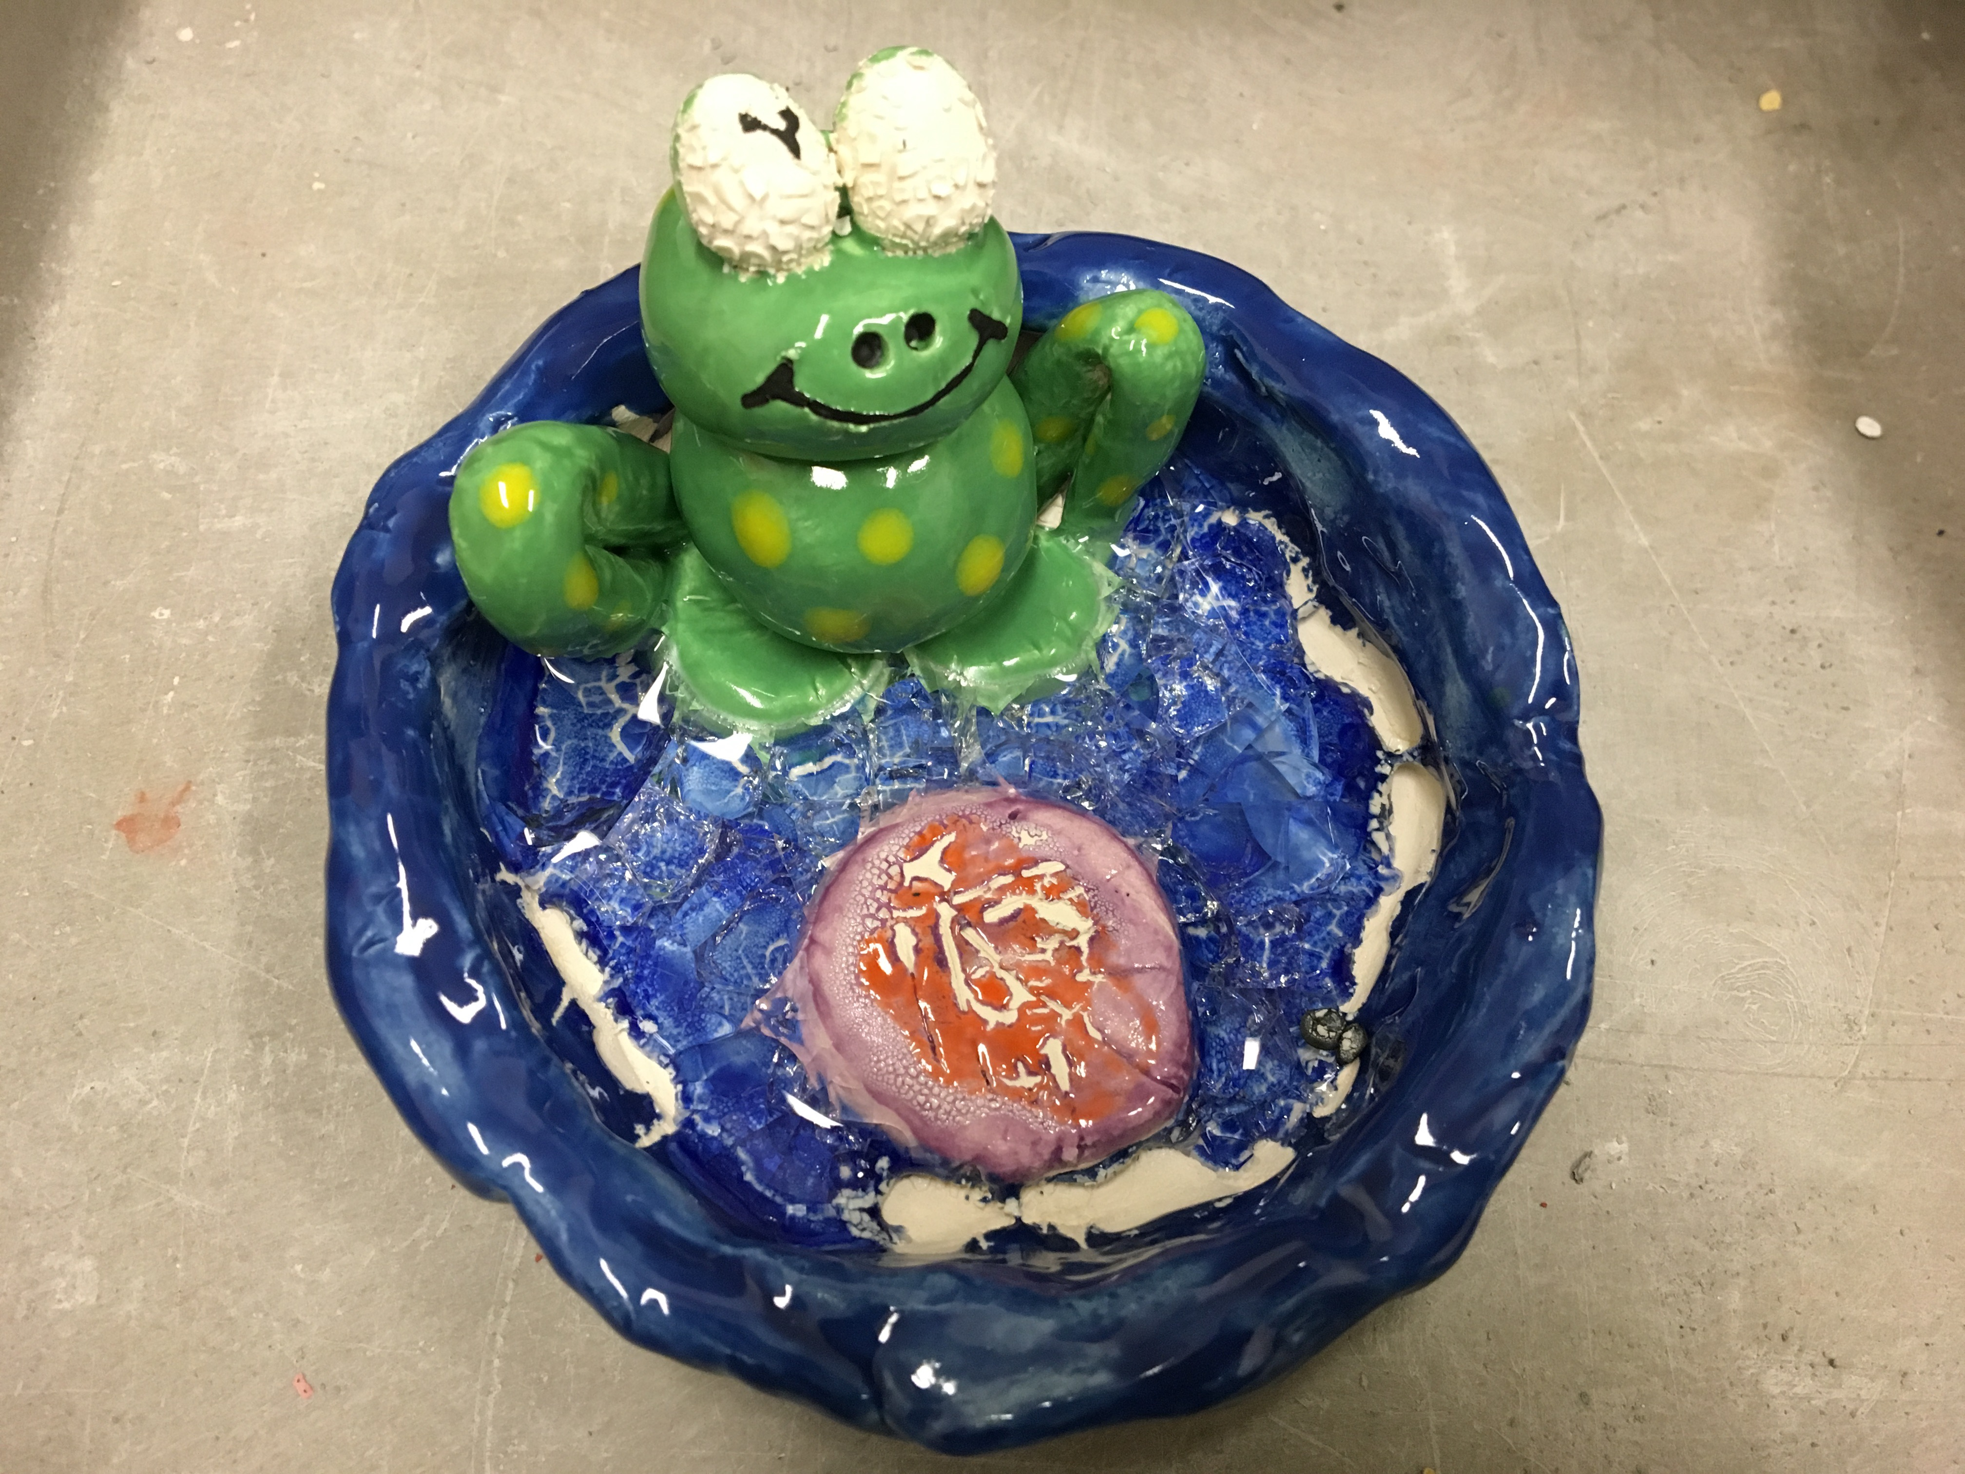

Slide 14
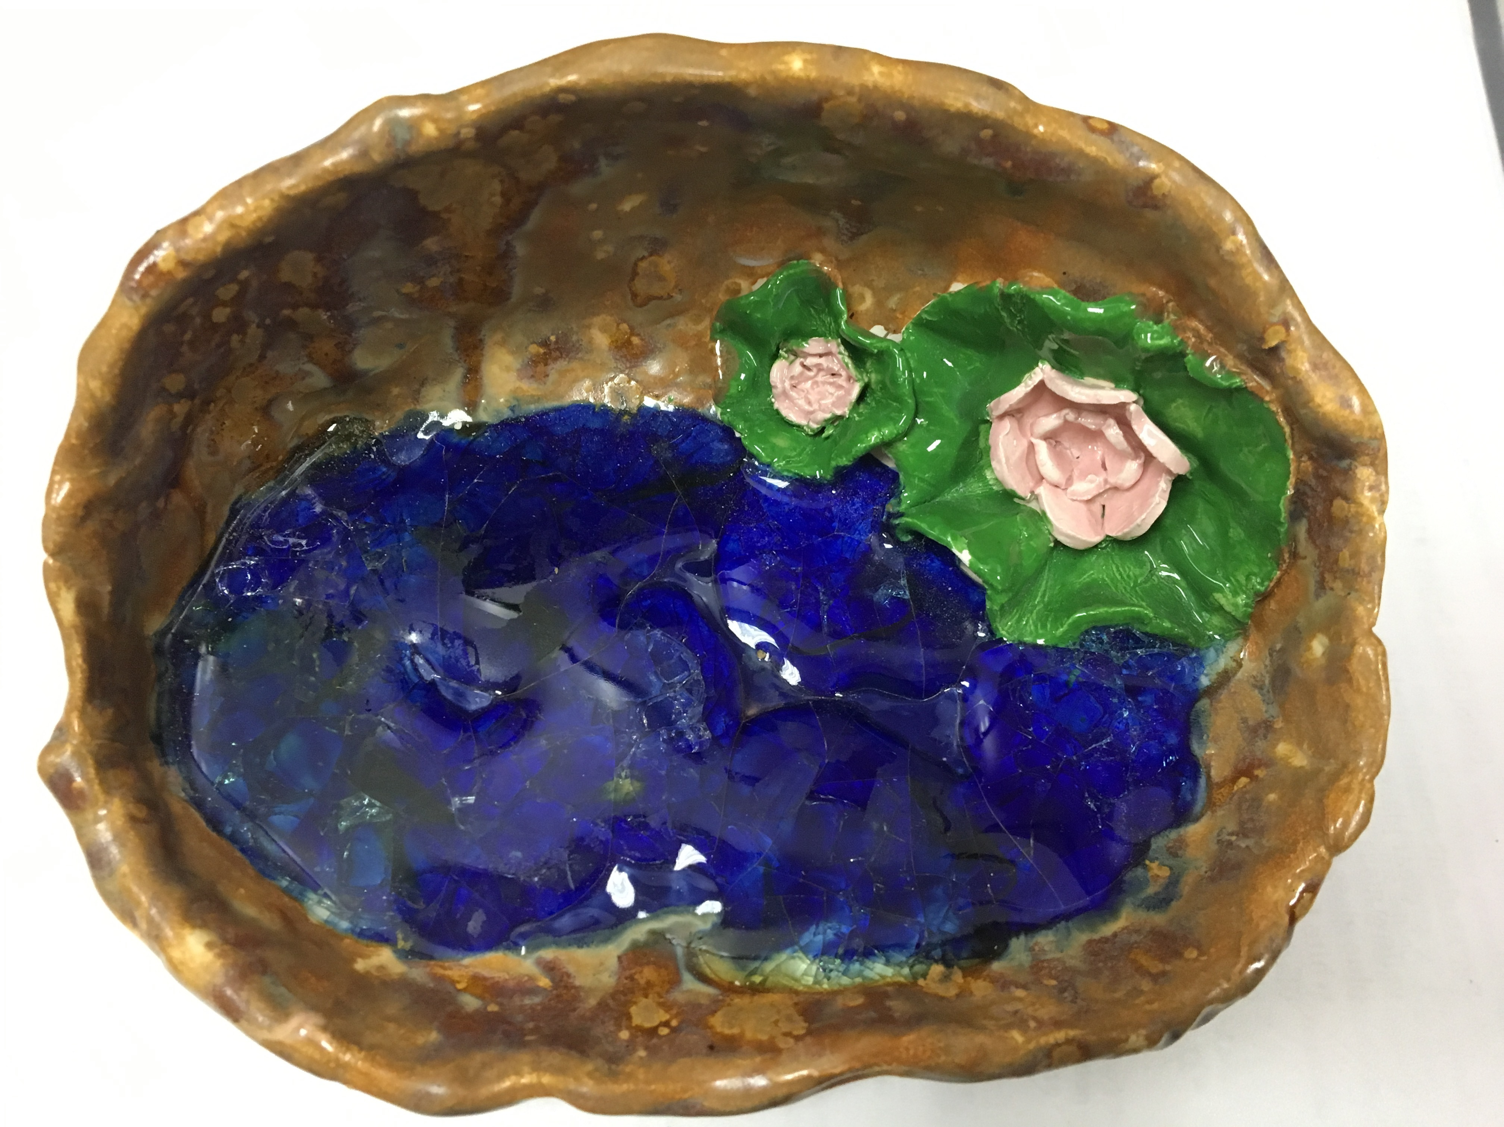

Slide 16
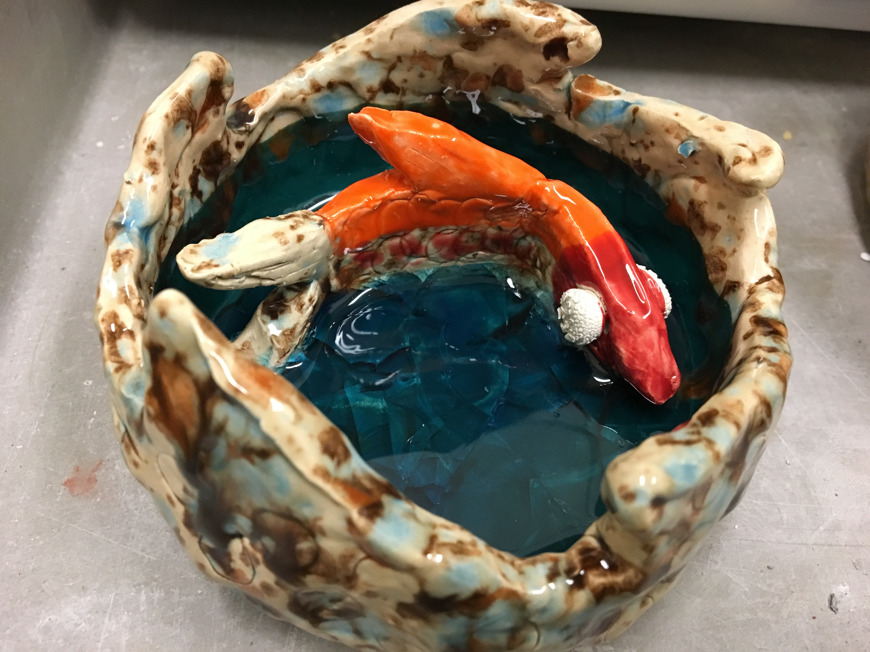

Slide 17
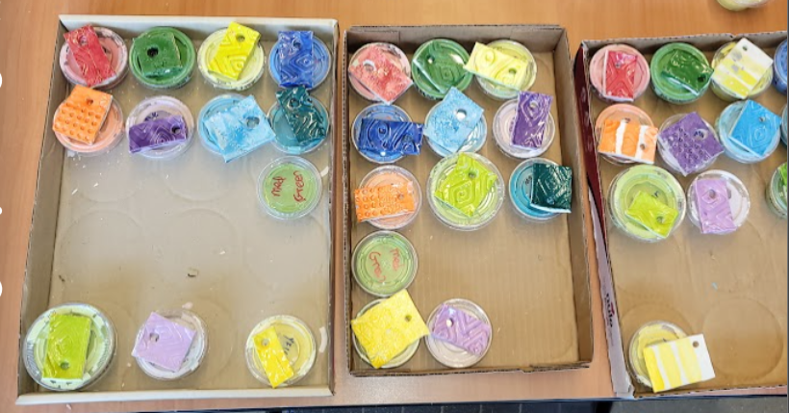
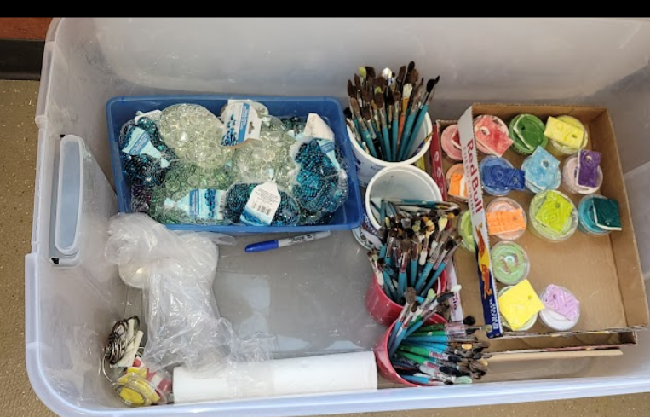
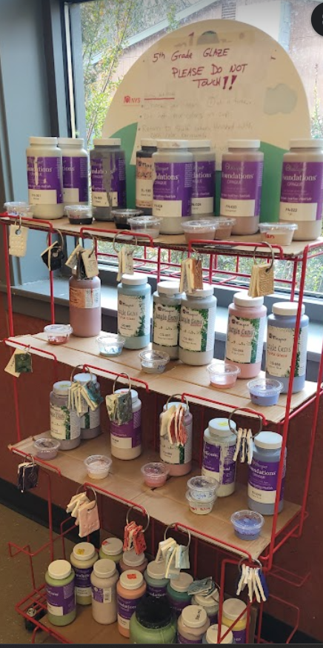
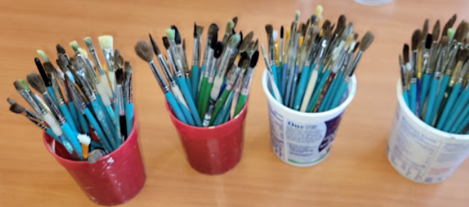
Docent Setup for Glazing
Cover tables with butcher paper.
Pre-pour the glazes into portion cups (label lid and cup with glaze name)
Set out one set of colors per table.
Set out a variety of brush sizes onto each table.
Pass out paper towels for finger wiping.
Consider setting up shelf with less common “specialty” colors, rather than pouring one for each table.

Slide 18
Glaze Instructions when using the shelf method:
Only 3 people at the shelf at one time.
Choose 1 color at a time.
Take the to go cup and 1 sample tile to your seat.
Return the first cup and tile before getting a new color.
Return the cup and tile as soon as you are finished using it.

Slide 19
Docent information for Glazing Steps
One Color per Brush
Choose the right size for the small details
Use larger brush for exterior areas that use larger amounts of glaze.
Most glazes look best with a minimum of 3 coats of glaze. The glaze is applied with a paintbrush but does not go on like paint. The liquid in the glaze will be pulled into the bisque clay causing it to dry very quickly.
Apply the glaze in thin layers between each coat, so that it has time to dry before the next coat.
Some glazes (like Red and some Crystal Glazes, need 4-5 coats)
Use the brush to blot the glaze into cervices and deep areas.
Glaze does not run when it is fired. It stays right where it is painted. Make sure you do not leave any white bisque showing. Use the round brushes to dab glaze into deep holes and crevasse in order to get proper coverage.
Remember to glaze the sides of all 3D objects and any place that can be seen from all angles.
Do not glaze the bottom of the projects.
Leave no white bisque showing. If you want white to show, use white glaze

Slide 20
Glazing Instructions to Students
It is cleaner and easier to start from the inside of your bowl and work your way outward.
Start with the interior bottom of your bowl
Once dry, move onto the walls and ceiling of your bowl (if a shell).
Once dry, move on to your creature or scene details.
Last, glaze the outside of the bowl or shell.

Slide 21
Student Glaze instructions continued…
Do not mix glazes.
1 color per brush.
Choose the correct size brush for the job
Keep the lid on the glaze cup when not using it. Keep the sample tile with the cup.
Paint on 3-4 coats of glaze. Thin coats dry faster.
Do not move onto the next color until you have completed your 3rd coat of glaze in the previous area.
Do not leave any white bisque showing. If you want white areas, then use white glaze.

Slide 22
Students - When you are finished
Clean up your work area. Put lids back on cups, take dirty brushes to sink to be washed. Throw away paper towels.
Choose one glass bead color and place it in your bowl.
Put your bowl on the cart (or where you are directed to place it)
Wash your hands.
After you return to class, the art docent will put the right amount of glass beads into your bowl, based on the bowl size and the color bead you selected.
Bowls will be placed in the kiln to fire.

